Slide 1
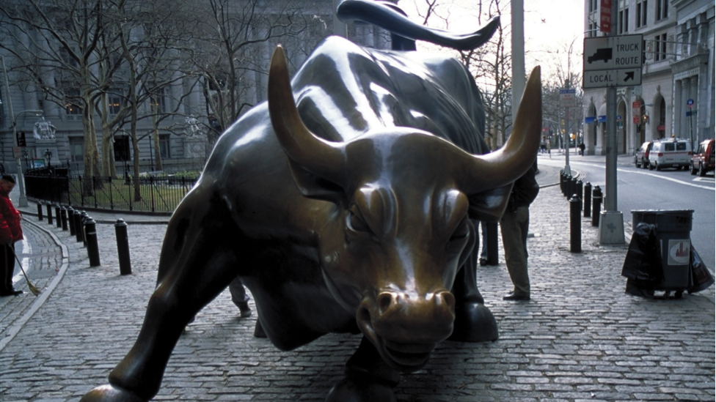
Investment Portfolio Summary
Presented by
Yan Ge & Lebo Sango
FIN 6160 – Equity Securities & Markets
2024 Spring Semester

Slide 2
Presentation Outline
Investment Portfolio & Market News Summary
Portfolio Security Descriptions
Investment Strategies
General rules
Contruction rules
Management rules
Transaction Details
Investment Portfolio Performance Analysis
Final Remarks

Slide 3
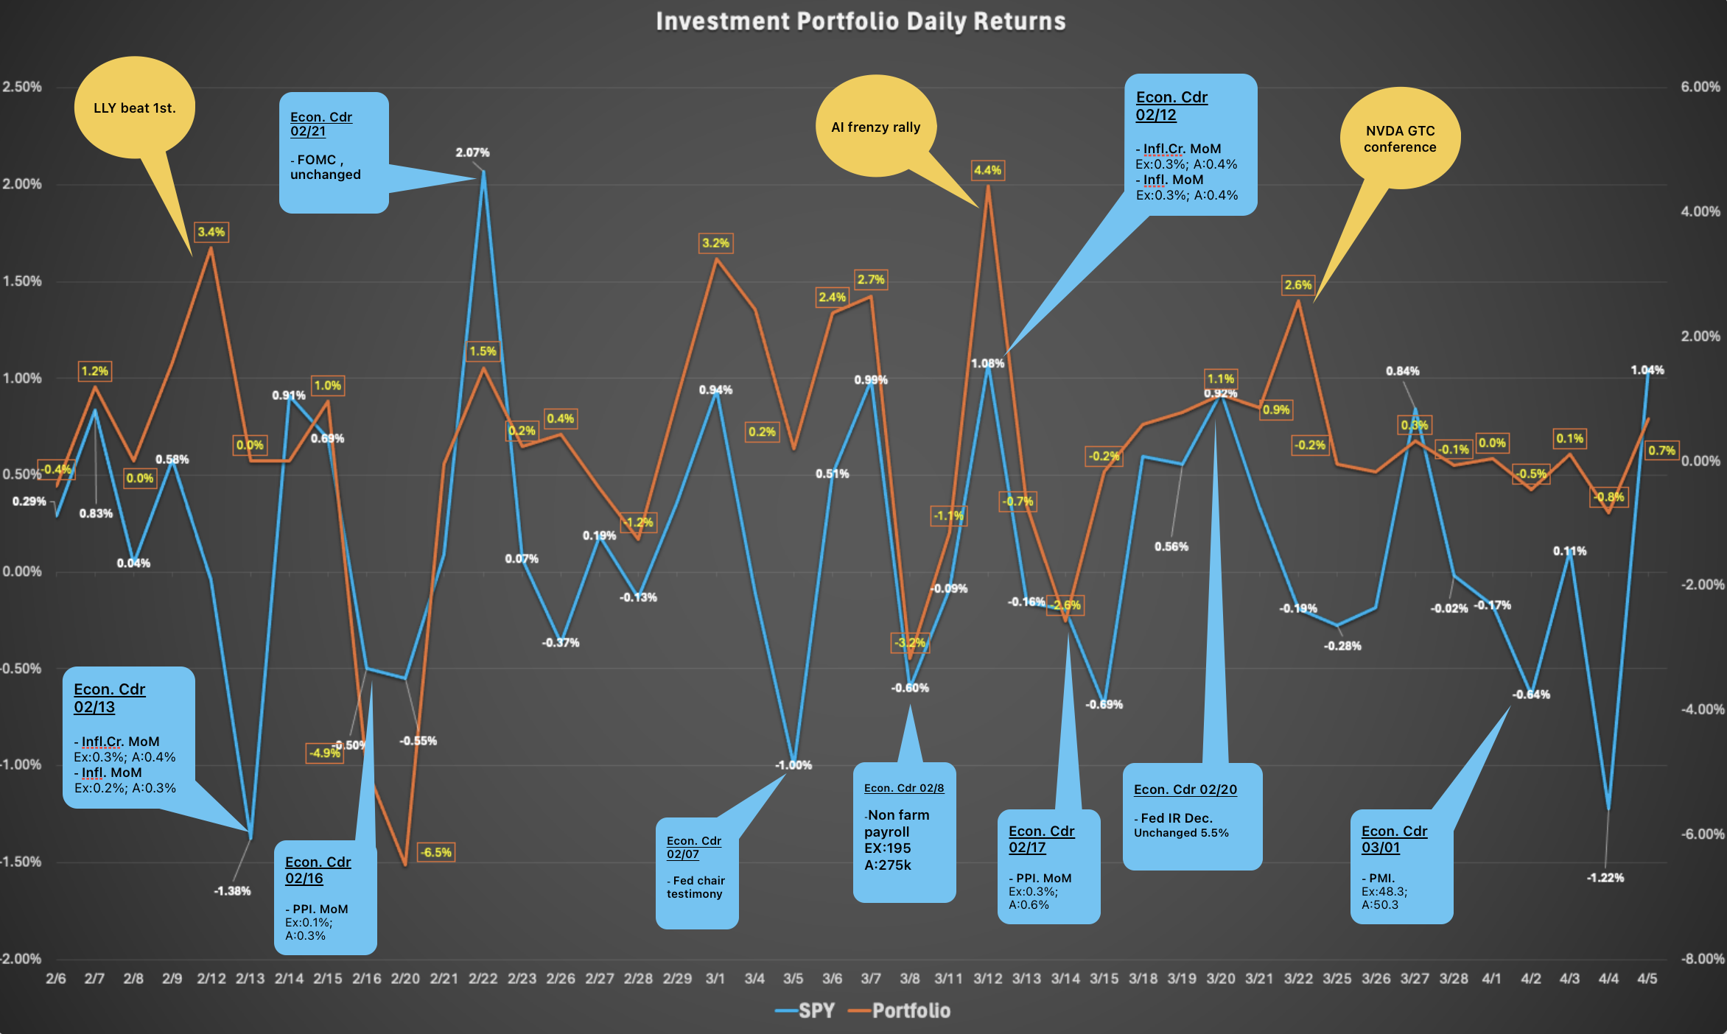
Investment Portfolio & Market News Recap

Slide 4
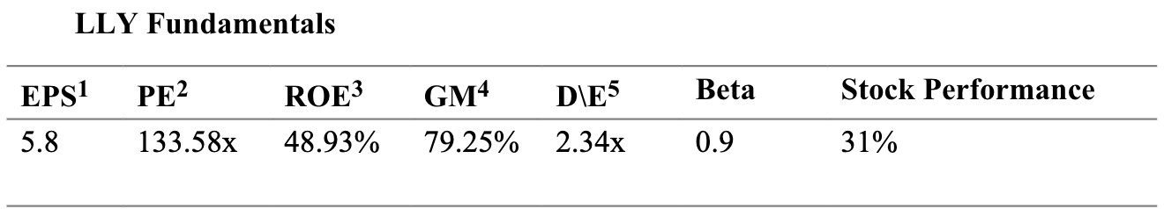
II. Investment Portfolio Security Descriptions
Health Care
Industry : Pharmaceuticals
Eli Lilly & Co – LLY
Founded in 1876 ; headquarters in Indianapolis
Market cap : $714.6B
The company manufactures drugs such as human products, immunology products and neuroscience products.
The company product distributions extend from the United States, South America, Europe and Asia.

Slide 5
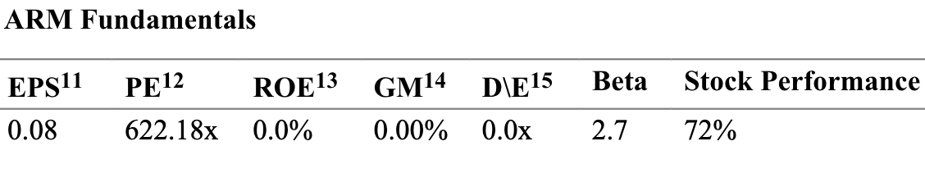
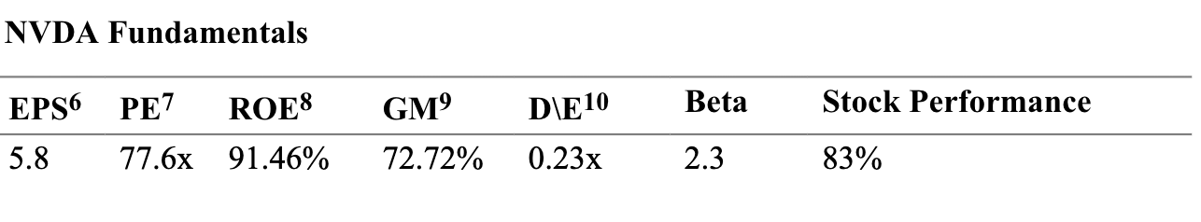
II. Investment Portfolio Security Descriptions:
Technology
Semiconductors & Semiconductor Equipment
ARM HOLDINGS PLC SPONSORED ADR - ARM
Founded 1990 ; England-Cambridge
Market cap: $129.9B
The company develops and licenses IP and develop tools that accelerate product development such as CPUs, NPUs, etc.
NVIDIA CORPORATION COM – NVIDA
Founded in 1993; headquarter US
Market cap : $2.2T
The company's segments include compute & Networking and Graphics.

Slide 6
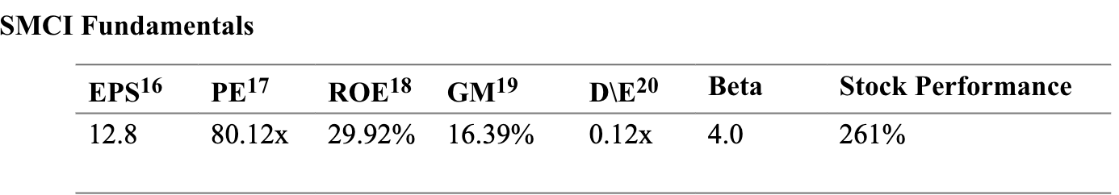
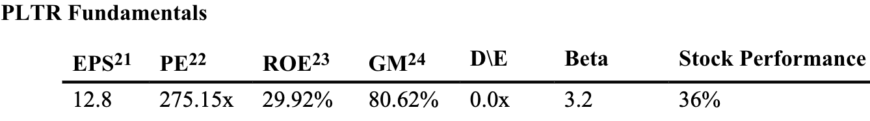
II. Investment Portfolio Security Descriptions:
Technology
Computers, Phones & Household Electronics
Software and IT Services
SSUPER MICRO COMPUTER INC COM - SMCI
Founded 1993 ; San Jose CA, US
Market cap: $52.6B
The Company provides Silicon Valley-based provider of accelerated compute platforms that are application-optimized server and storage systems for a variety of markets, including enterprise data centers, cloud computing, artificial intelligence (AI), fifth generation (5G) and edge computing
PALANTIR TECHNOLOGIES INC CL A - PLTR
Founded in 2003; Denver CO
Market cap : $50.1B
is engaged in building software to assist in counterterrorism investigations and operations. It has built four principal software platforms, including Palantir Gotham (Gotham), Palantir Foundry (Foundry), Palantir Apollo (Apollo), and Palantir Artificial Intelligence Platform (AIP)

Slide 7
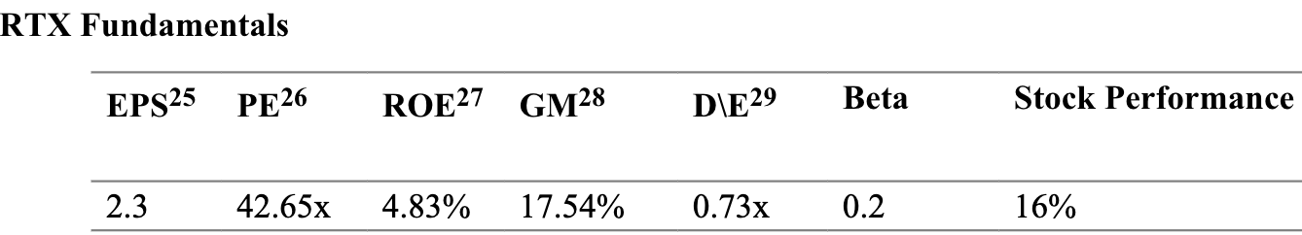
II. Investment Portfolio Security Descriptions
Industrials
Industry : Defense & Aerospace
RTX
Founded in 2020 ; headquarters in Arlington
Market cap : $133.1B
RTX Corporation is an aerospace and defense company, which provides advanced systems and services for commercial, military, and government customers worldwide.

Slide 8

III. Investment Strategies
General Rules
Macroeconomic developments
Sector identification
Company Events
High transaction volume

Slide 9

III. Investment Strategies
Construction Rules
Strong Fundamental Indicators
Deals & Partnerships
AI Adoption

Slide 10
III. Investment Strategies
Management Rules
•Moving Average Convergence Divergence (MACD) and Bollinger Bands
•The MACD is instrumental in identifying momentum shifts and potential trend reversals by evaluating the relationship between two moving averages of a security's price.
•Bollinger Bands provides insights into price volatility and overbought or oversold conditions by plotting standard deviation levels around a moving average.
•Setting precise stop-loss and stop-gain targets
•Aim to minimize exposure by avoiding the augmentation of positions shortly before these critical data are released.

Slide 11
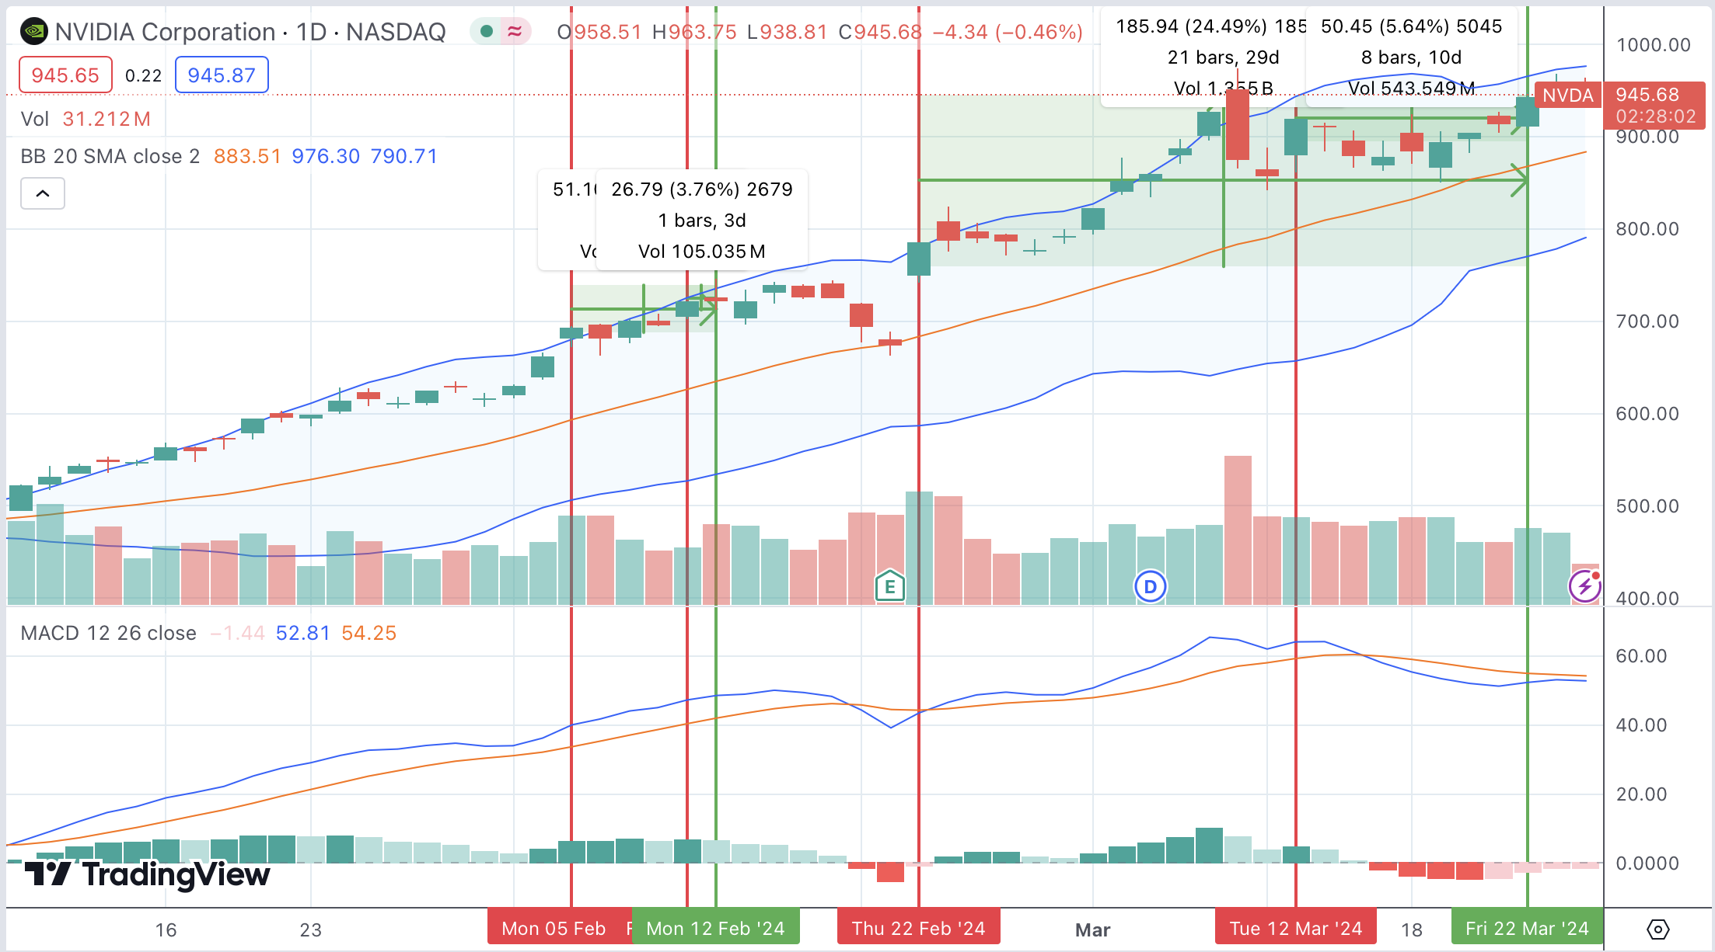
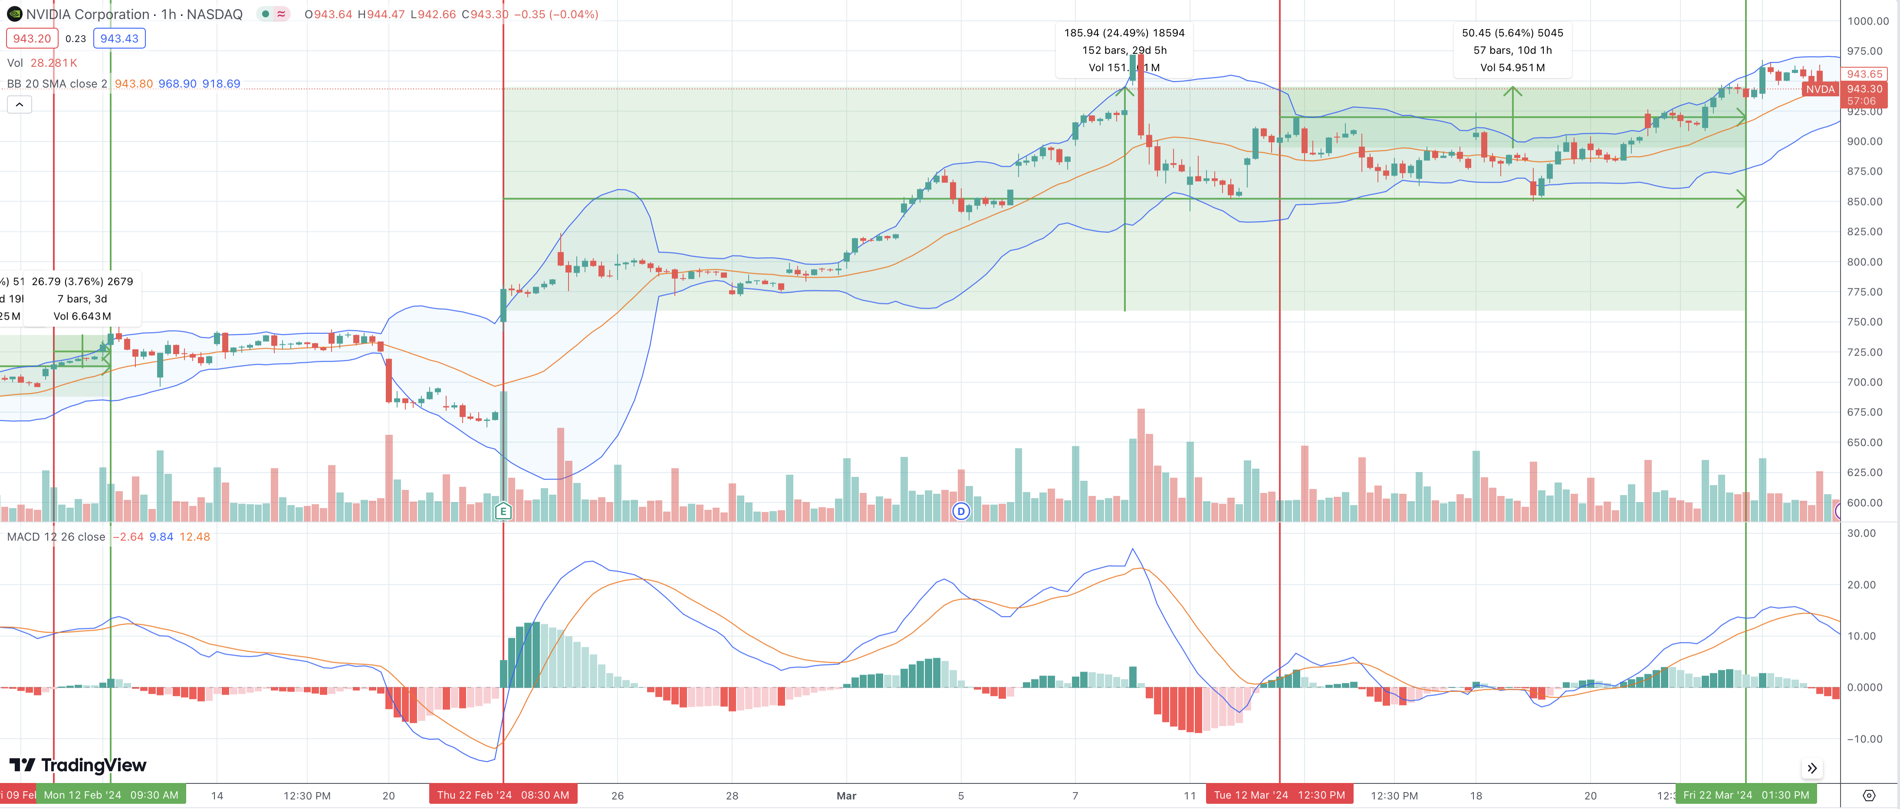
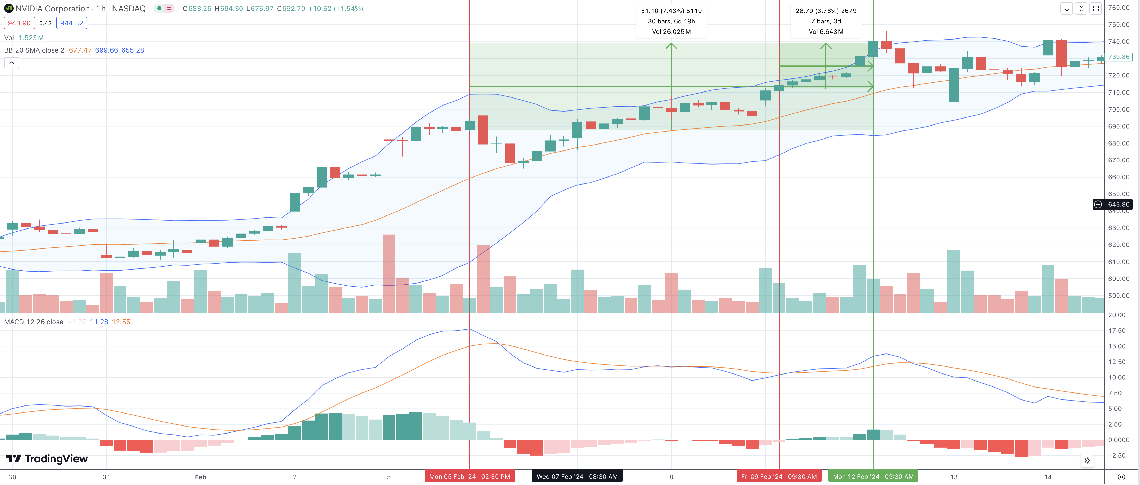
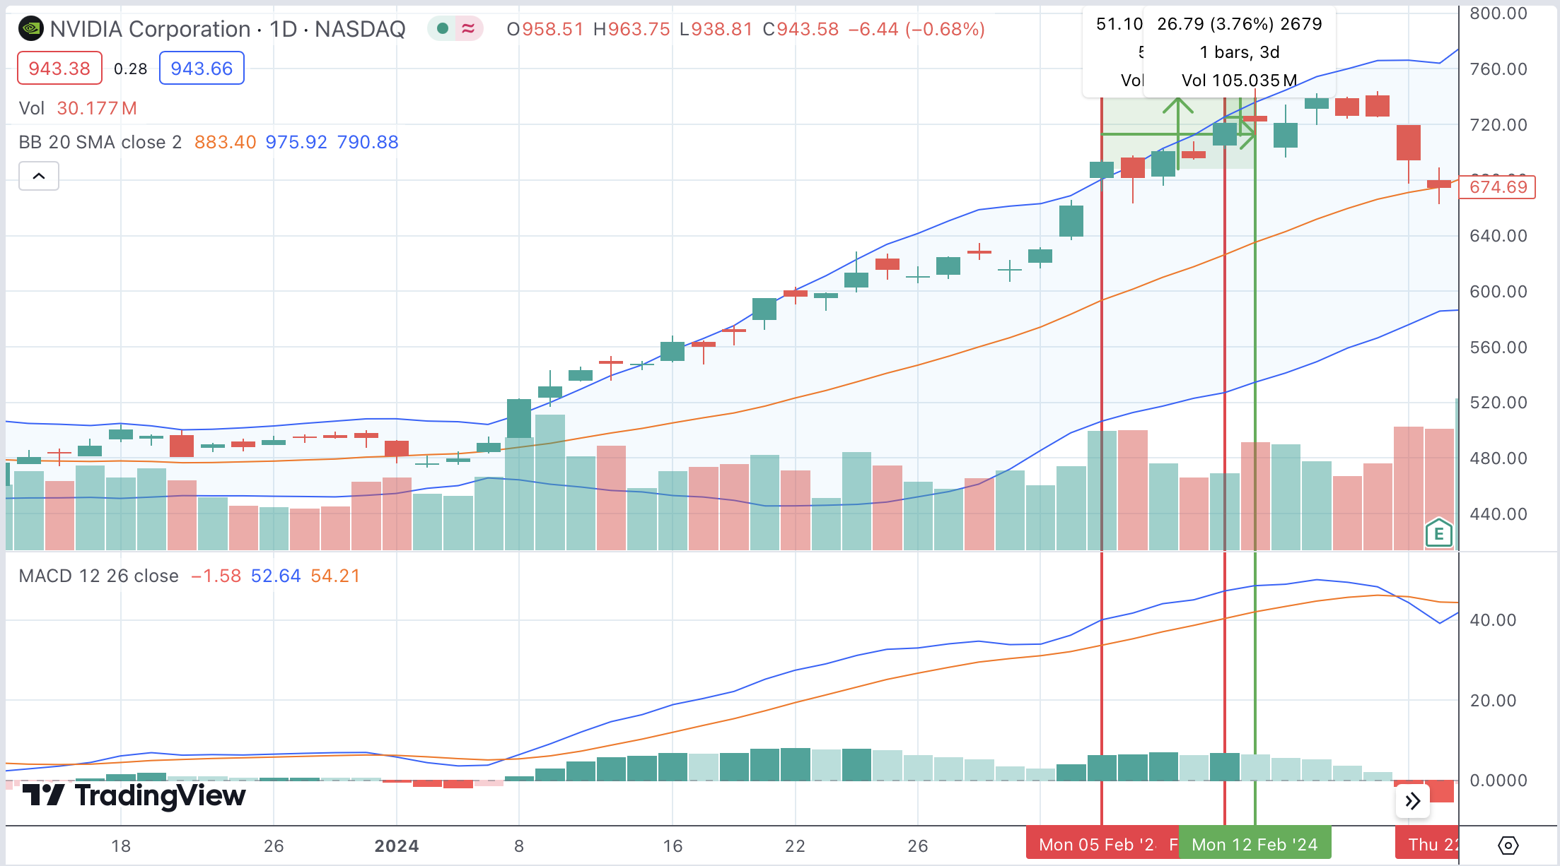
IV. Transaction Details--NVIDIA​
HPR: 19.68%

Slide 12
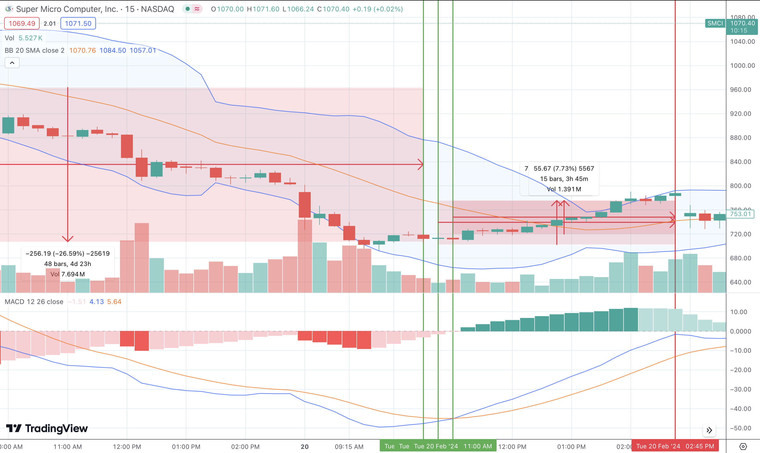
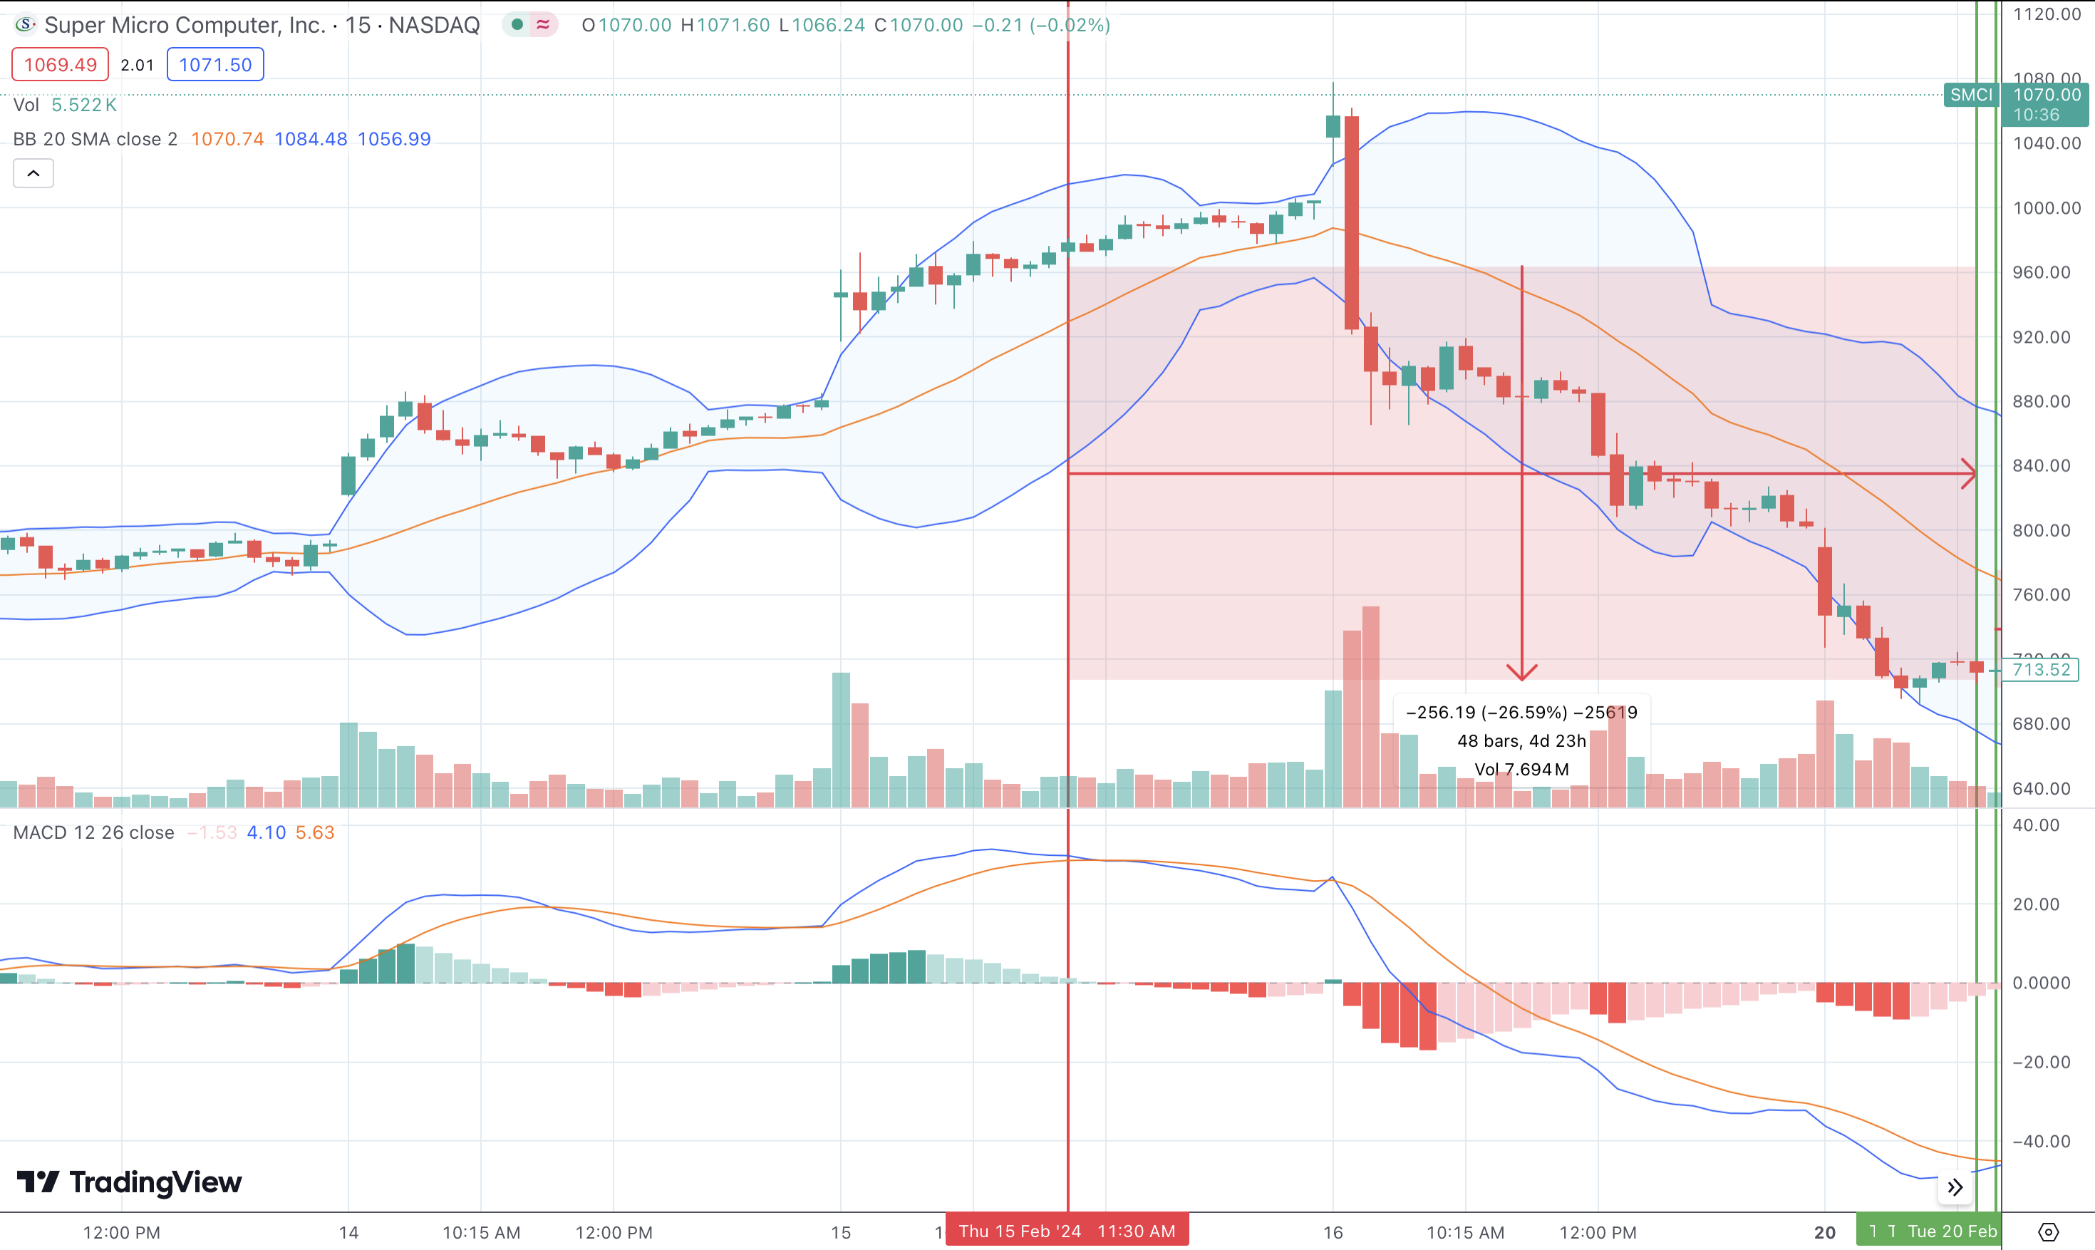
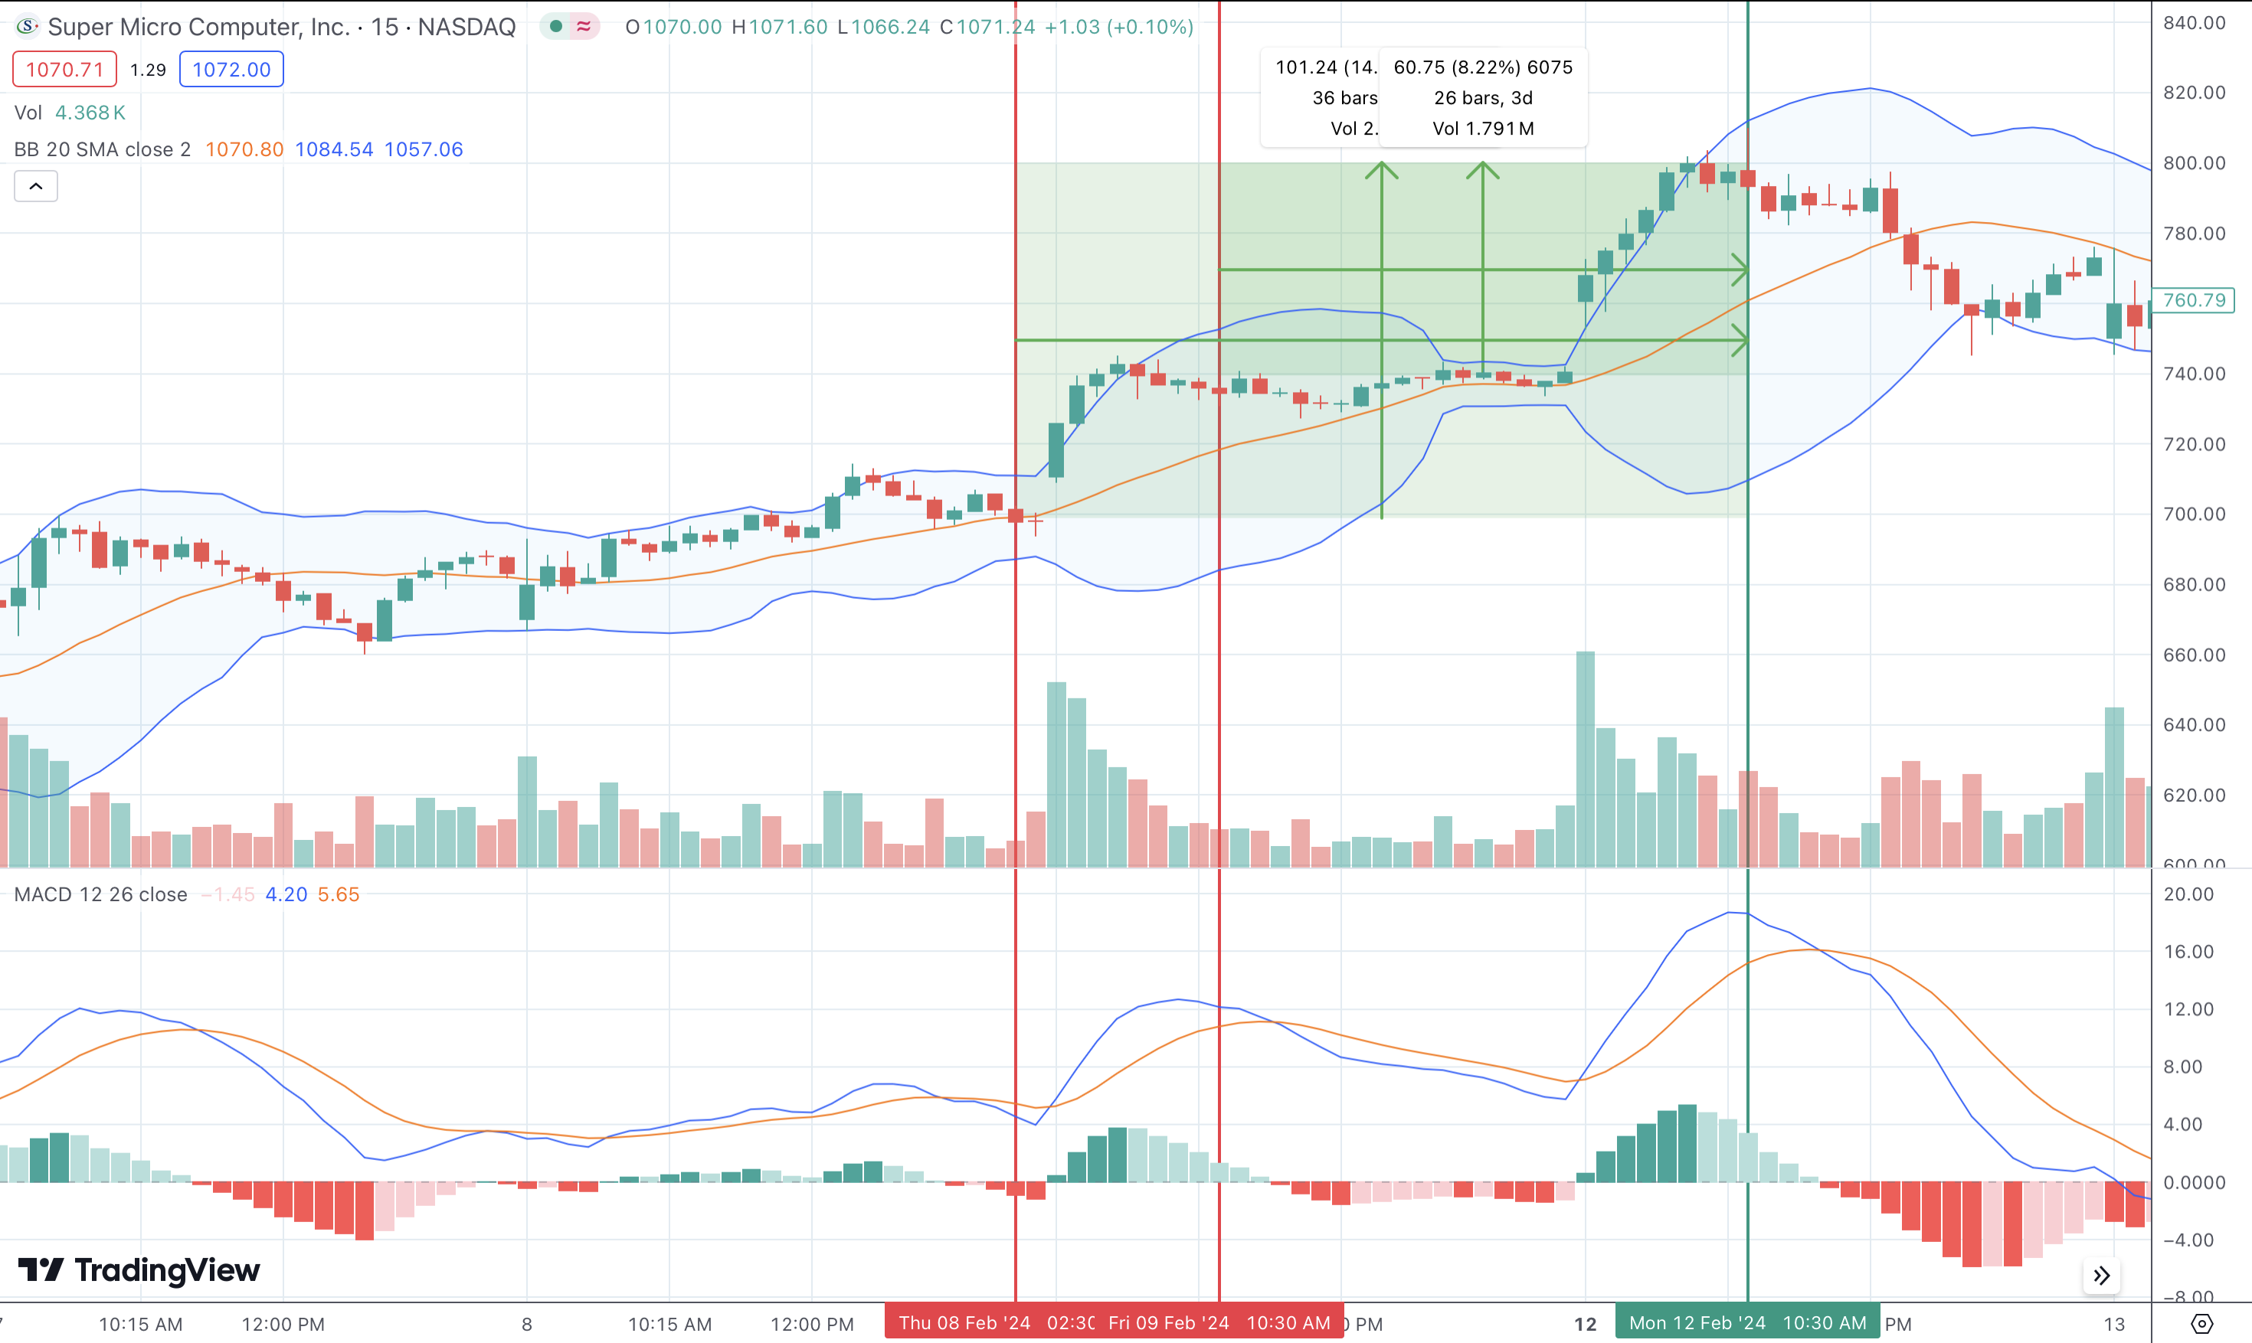
IV. Transaction Details--SMCI​
HPR: -7.34%

Slide 13
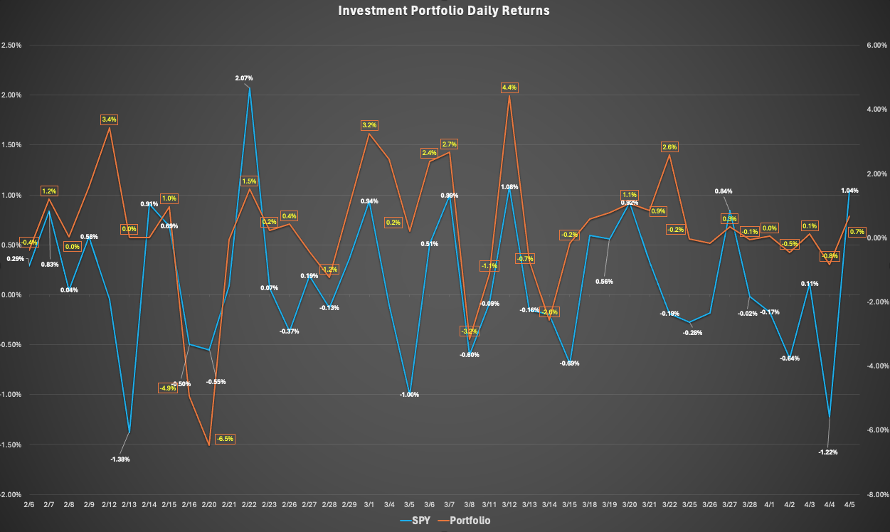
V. Investment Portfolio Performance Analysis​
 | SPY | Portfolio
Net return | 5.58% | 9.53%
Daily return | 0.13% | 0.22%
APR | 60.32% | 119.95%
Std. Deviation | 0.68% | 1.98%
Sharp ratio | 17.34% | 10.36%
Covariance | 0.0067%
Free-risk rate | 4.24%
Daily free-risk rate | 0.01%
Beta | 2.9059
Alpha | -5.2975%

Slide 14
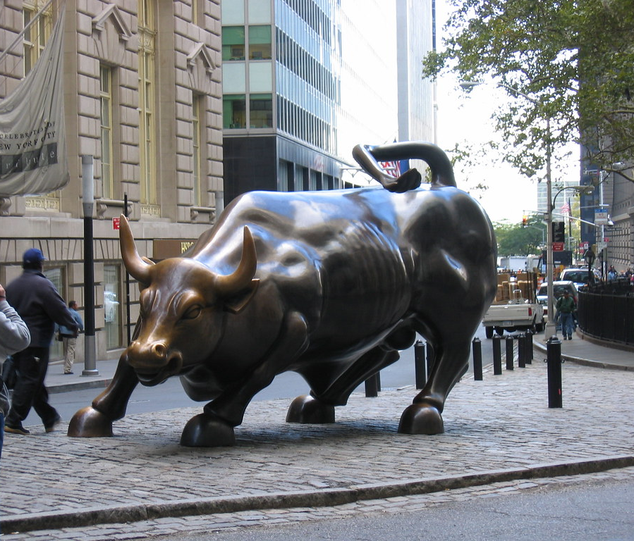

VI. Final Remarks
Economic Landscape:
Economic calendars
Company events
Technical and Fundamental Analysis:
MACD and Bollinger Bands
Risk Management :
Stop Loss Order
Limit sell
Realized gain
Investment success:
Avoidance of emotional trading
Thorough understanding of investment subjects

